Slide 1


Predicting Heart Disease
with Machine Learning
SIC – AI802
Notes:
1.7.2013
Note:
1
‹#›

Slide 2
Agenda
    Problem
    Solution
    Data Overview
    Data preprocessing techniques
    Exploratory data analysis
    Model training & Evaluation
    Which is best model
    Business insights / recommendations
Samsung Innovation Campus

Slide 3

Team members
Habeba Mahmoud
Nouran Sameh
Mark sedky Halim
Osama Mohamed
Samsung Innovation Campus

Slide 4
Problem Statement
Samsung Innovation Campus
Notes:
1.7.2013
Note:
2
‹#›

Slide 5

Problem Statement
Heart disease can be difficult to detect early. We aim to build a Machine Learning model that predicts whether a patient has heart disease based on their medical and clinical information
Samsung Innovation Campus

Slide 6
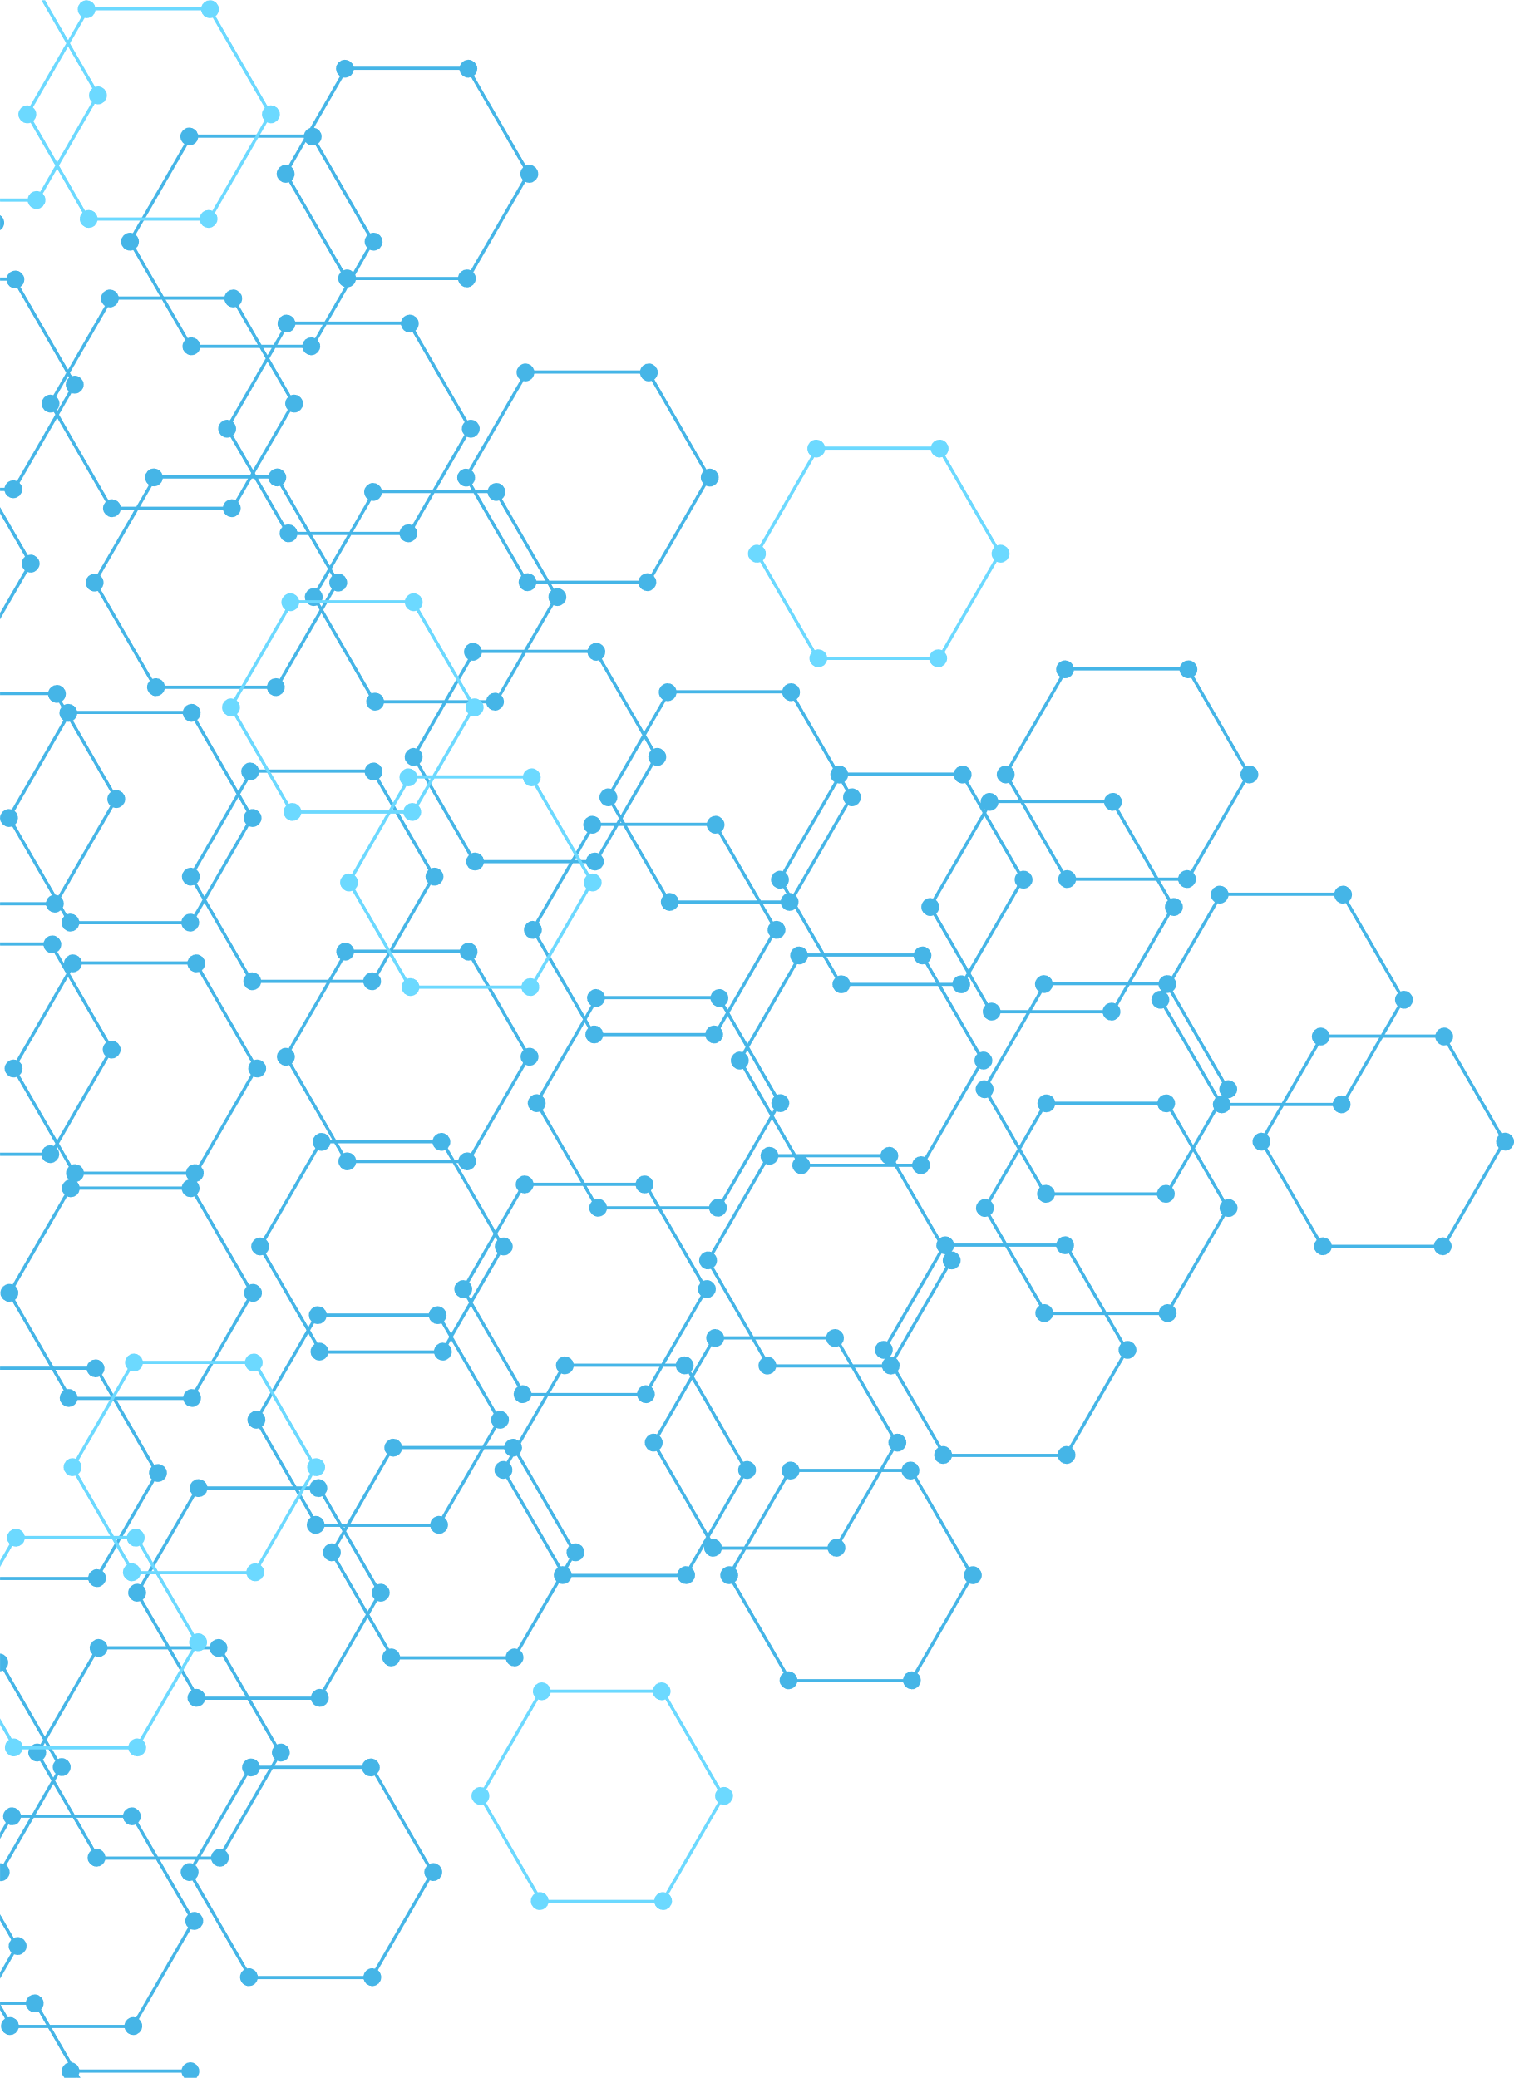

Objective
Predict whether a patient has Heart Disease or No Heart Disease.
We built a Machine Learning classification pipeline to analyze patient data and predict heart disease.
Samsung Innovation Campus

Slide 7
Data overview
Samsung Innovation Campus
Notes:
1.7.2013
Note:
2
‹#›

Slide 8
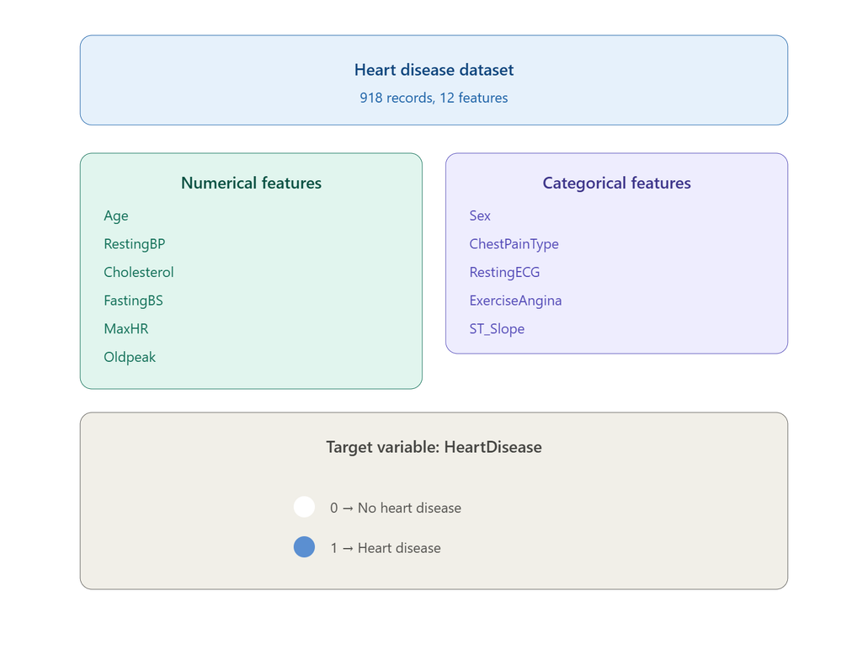
Data overview
Samsung Innovation Campus

Slide 9
Preprocessing
Samsung Innovation Campus
Notes:
1.7.2013
Note:
2
‹#›

Slide 10
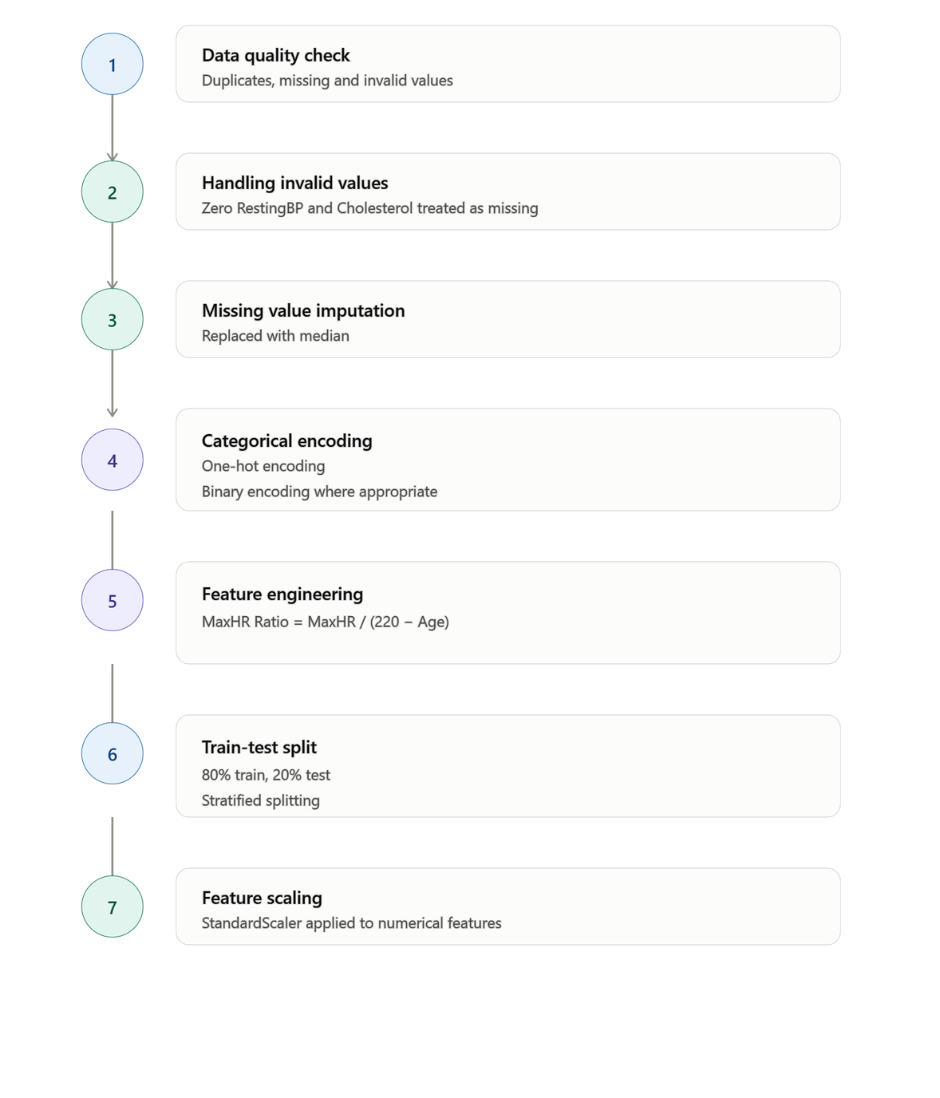
Preprocessing
Samsung Innovation Campus
Notes:
1.7.2013
Note:
4
‹#›

Slide 11
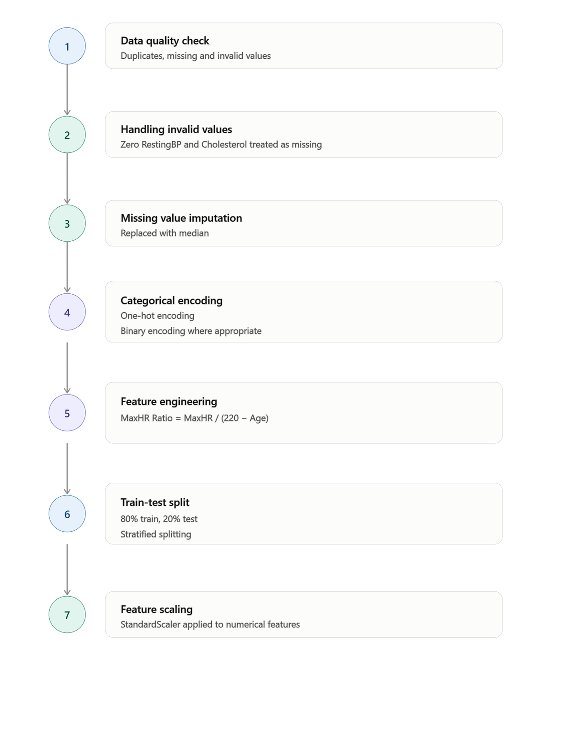
Preprocessing
Samsung Innovation Campus
Notes:
1.7.2013
Note:
4
‹#›

Slide 12
Exploratory Data Analysis
Samsung Innovation Campus
Notes:
1.7.2013
Note:
2
‹#›

Slide 13
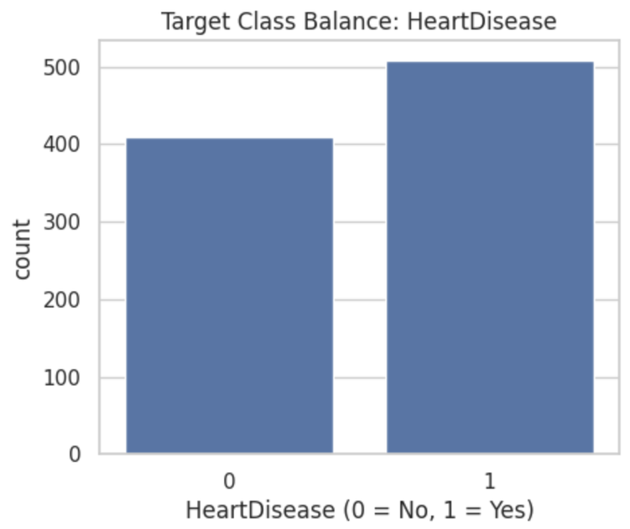
Target Distribution
The target is relatively balanced, with a slight difference between the two classes.
Samsung Innovation Campus

Slide 14
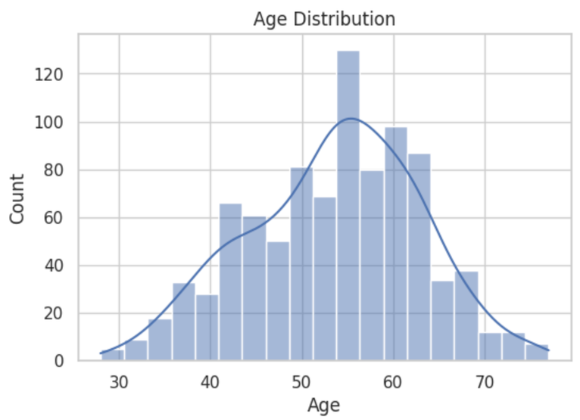
Age Distribution
  Age ranges from approximately 28 to 77 years.
  Most patients are concentrated around 45–60 years.
Samsung Innovation Campus

Slide 15
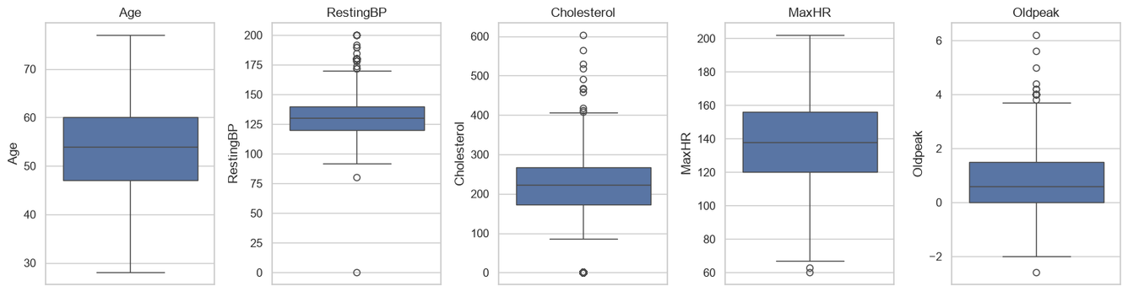
Numerical Features & Outliers
There were detected outliers.
Outliers were not automatically removed because they may represent valid medical observations.
Samsung Innovation Campus

Slide 16
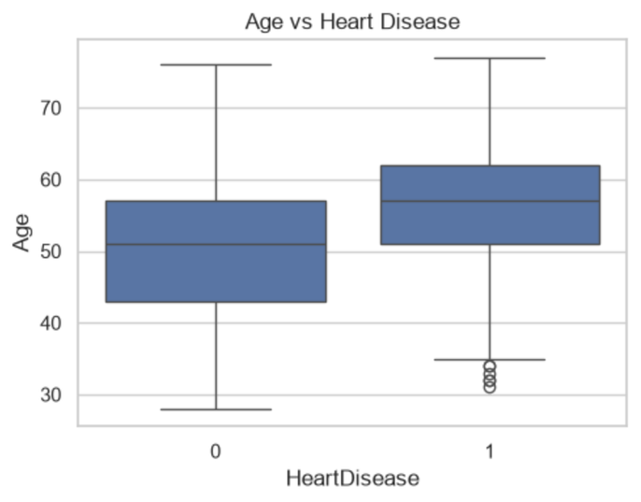
Age vs Heart Disease
Patients with Heart Disease tend to be older (55–65)
This suggests that Age is an important predictive feature.
Samsung Innovation Campus

Slide 17
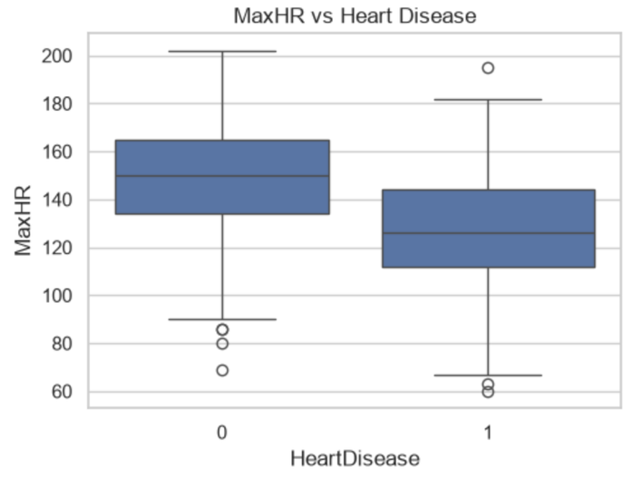
MaxHR vs Heart Disease
Patients with Heart Disease tend to have a lower MaxHR.
This indicates a potential relationship between MaxHR and Heart Disease.
Samsung Innovation Campus

Slide 18
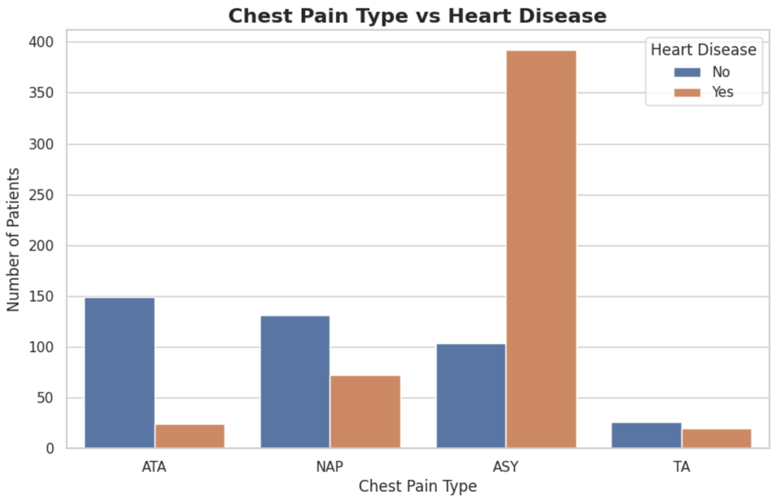
Chest Pain Type vs Heart Disease
Asymptomatic (ASY) is strongly associated with Heart Disease in this dataset.
Samsung Innovation Campus

Slide 19
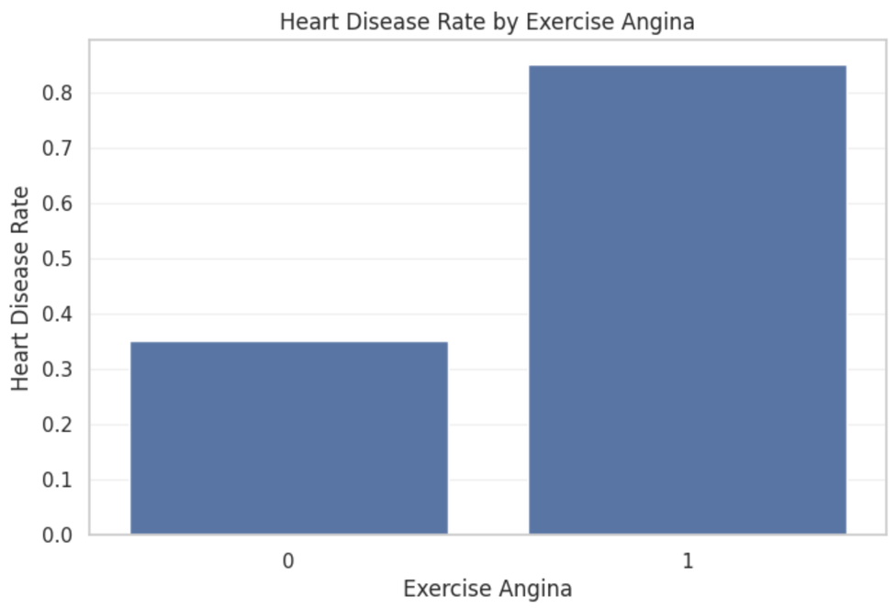
Exercise Angina vs Heart Disease
Patients with Exercise Angina = Yes have a higher heart disease rate.
Samsung Innovation Campus

Slide 20
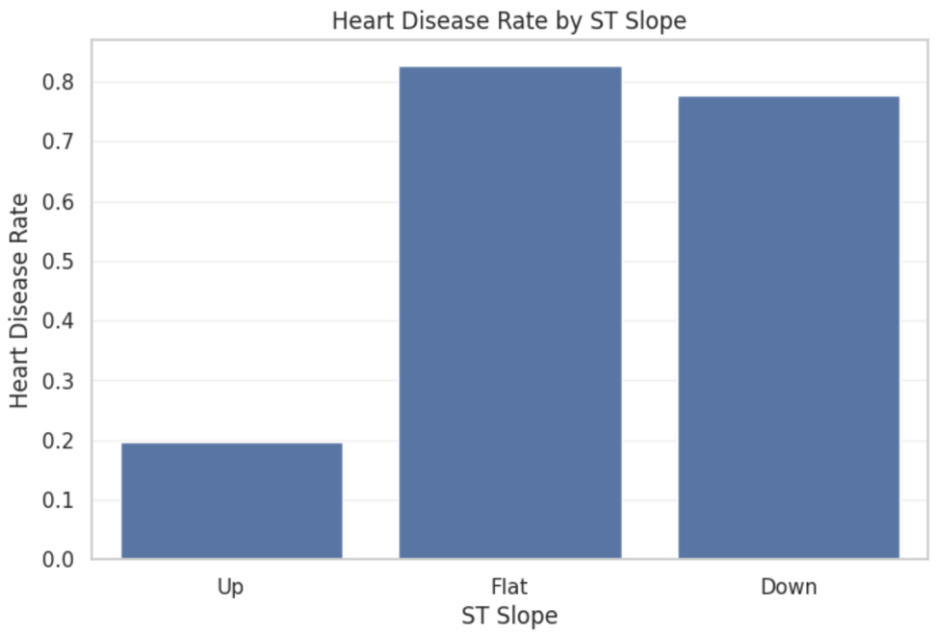
ST Slope vs Heart Disease
Flat is strongly associated with Heart Disease in this dataset.
Samsung Innovation Campus

Slide 21
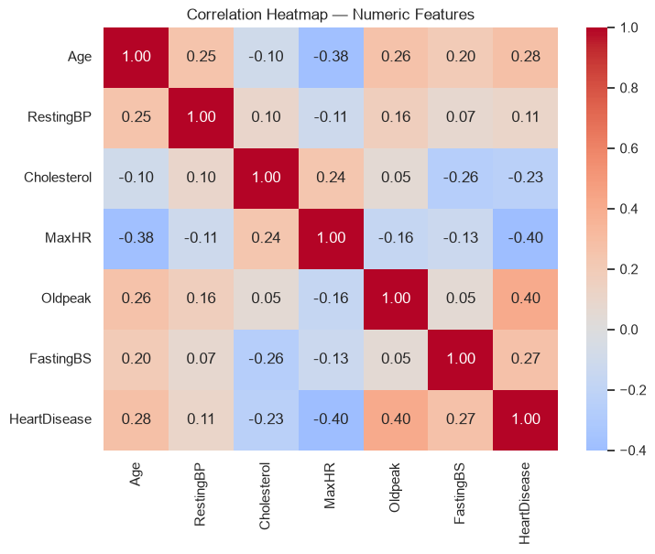
Correlation HeatMap
  Oldpeak: moderate positive correlation with Heart Disease → 0.40
  MaxHR: moderate negative correlation → −0.40
  Age: weak–moderate positive correlation → 0.28
  FastingBS: weak–moderate positive correlation → 0.27
  Cholesterol: weak negative correlation → −0.23
  RestingBP: very weak positive correlation → 0.11
Samsung Innovation Campus

Slide 22
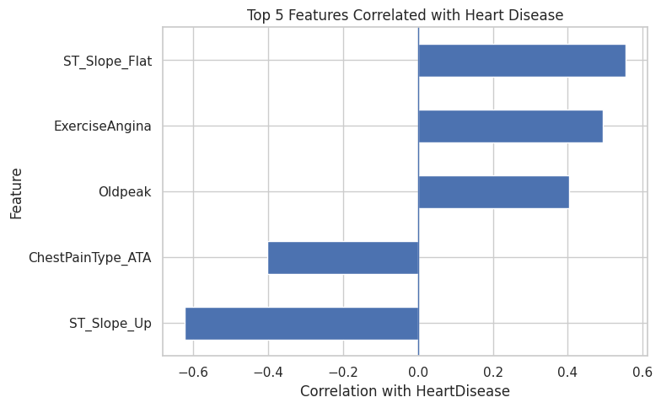
Top 5 Correlation with heart disease
ST_Slope and ExerciseAngina show the strongest relationships with HeartDisease, highlighting their importance as predictive features.
Samsung Innovation Campus

Slide 23

Models
Samsung Innovation Campus
Notes:
1.7.2013
Note:
2
‹#›

Slide 24
Tree-Based Models
A decision tree learns simple if/else rules on feature values; a random forest averages many such trees to reduce overfitting.
DT
Decision Tree
RF
Random Forest
Recursively splits the data on the feature/threshold that best separates the classes, forming a tree of if/else rules down to a prediction.
Trains many decision trees on random subsets of the data and features, then combines their votes — an ensemble that lowers variance versus a single tree.
Test Accuracy: 0.75
Test Precision: 0.78
Test Recall: 0.7647
Test F1: 0.772
DT ROC-AUC: 0.748
Test Accuracy: 0.86
Test Precision: 0.88
Test Recall: 0.87
Test F1: 0.87
DT ROC-AUC: 0.93
Samsung Innovation Campus

Slide 25
Boosting Models
Boosting builds trees sequentially, where each new tree focuses on correcting the errors left by the ones before it.
GB
Gradient Boosting
XGB
XGBoost
Adds shallow trees one at a time, each trained to predict the residual errors of the current ensemble, gradually reducing the loss.
A regularized, optimized implementation of gradient boosting that adds trees to minimize a loss function while penalizing complexity to control overfitting.
Test Accuracy: 0.897
Test Precision: 0.888
Test Recall: 0.93
Test F1: 0.909
DT ROC-AUC: 0.93
Test Accuracy: 0.891
Test Precision: 0.887
Test Recall: 0.92
Test F1: 0.904
DT ROC-AUC: 0.930
Samsung Innovation Campus

Slide 26
Linear, Kernel & Instance-Based Models
Three different strategies for drawing a decision boundary: a linear equation, a kernel-projected margin, and a vote among nearby points.
LR
SVM
KNN
Logistic Regression
SVM (RBF Kernel)
K-Nearest Neighbors
Fits a linear combination of the features to model the log-odds of heart disease, converting it to a probability via the sigmoid function.
Finds the boundary with the widest margin between classes; the RBF kernel projects features into a higher dimension to separate non-linear patterns.
Classifies a patient by majority vote among the K most similar patients in the training set, based on distance in feature space.
Test Accuracy: 0.891
Test Precision: 0.894
Test Recall: 0.912
Test F1: 0.903
DT ROC-AUC: 0.933
Test Accuracy: 0.859
Test Precision: 0.880
Test Recall: 0.863
Test F1: 0.871
DT ROC-AUC: 0.935
Test Accuracy: 0.859
Test Precision: 0.888
Test Recall: 0.853
Test F1: 0.870
DT ROC-AUC: 0.928
Samsung Innovation Campus

Slide 27
Evaluation
Samsung Innovation Campus
Notes:
1.7.2013
Note:
2
‹#›

Slide 28
Evaluation Metrics
All 7 models scored on the held-out test set (20% split), ranked by F1-score.
Model | Accuracy | Precision | Recall | F1-Score | ROC-AUC
Gradient Boosting | 0.897 | 0.888 | 0.931 | 0.909 | 0.931
XGBoost | 0.886 | 0.886 | 0.912 | 0.899 | 0.928
Logistic Regression | 0.891 | 0.894 | 0.912 | 0.903 | 0.933
Random Forest | 0.864 | 0.881 | 0.873 | 0.877 | 0.928
SVM-RBF | 0.859 | 0.880 | 0.863 | 0.871 | 0.935
KNN | 0.859 | 0.888 | 0.853 | 0.870 | 0.928
Decision Tree | 0.750 | 0.780 | 0.765 | 0.772 | 0.748
Gradient Boosting leads on F1-score (0.909) and Recall (0.931); Decision Tree trails on every metric. Because the dataset is imbalanced, F1 — which balances Precision and Recall — is the primary metric used for ranking.
Samsung Innovation Campus

Slide 29
Performance Comparison
F1-Score by Model
Recall by Model
SVM-RBF has the single highest ROC-AUC (0.935), but Gradient Boosting, XGBoost and Logistic Regression are close behind (~0.93) — with very similar discrimination ability, ROC-AUC alone doesn't separate the top models.
Samsung Innovation Campus

Slide 30
Top Models & Final Decision
Pred:
Disease
Pred:
No Disease
Pred:
Disease
Pred:
No Disease
Pred:
Disease
Pred:
No Disease
Gradient Boosting
XGBoost
Logistic Regression
Actual:
Disease
100
TP
2
FN
Actual:
Disease
100
TP
2
FN
Actual:
Disease
93
TP
9
FN
Actual:
No Disease
37
FP
45
TN
Actual:
No Disease
36
FP
46
TN
Actual:
No Disease
11
FP
71
TN
Final Decision: Gradient Boosting
Highest F1-score (0.909) and Recall (0.931) among all 7 models, with only 2 false negatives out of 102 positive cases.
Logistic Regression produces fewer false positives (11), but misses 9 positive cases — a worse trade-off for a diagnostic task.
Because the dataset is imbalanced and this is a heart-disease screening application, minimizing missed diagnoses (false negatives) outweighs a modest increase in false positives.
Samsung Innovation Campus

Slide 31
Recommendations
Samsung Innovation Campus
Notes:
1.7.2013
Note:
2
‹#›

Slide 32
BUSINESS RECOMMENDATIONS
Support Early Diagnosis
1
Risk-Based Patient Management
2
3
Enhance Patient Care Efficiency
Samsung Innovation Campus

Slide 33
Future Enhancements
Samsung Innovation Campus
Notes:
1.7.2013
Note:
2
‹#›

Slide 34
Future Enhancements
1
2
Train the model on more data and richer features
Use the model's output as a risk score not only a yes/no prediction.
3
4
Develop a medical application
Continuous monitoring and updating
Samsung Innovation Campus

Slide 35

ⓒ2020 SAMSUNG. All rights reserved.
Samsung Electronics Corporate Citizenship Office holds the copyright of book.
This book is a literary property protected by copyright law so reprint and reproduction without permission are prohibited.
To use this book other than the curriculum of Samsung innovation Campus or to use the entire or part of this book, you must receive written consent from copyright holder.
Notes:
1.7.2013
14
‹#›

